Slide 1
Final Review
HUMAN LIFE DETECTION DURING FIRE
Batch Number: ISD-04
Under the Supervision of,
Prof.Monisha Gupta
Assistant Professor
School of Computer Science Engineering & Information Science
Presidency University
Roll Number | Student Name
20211ISD0007 | SUNKU SAI YASWANTH
20211ISD0015 | GAJJALA AKHILA
20211ISD0027 | K PAVAN KUMAR

Slide 2
Introduction
This project aims to develop a real-time detection system using YOLOv8 and YOLOv9 deep learning algorithms to identify humans, fire, and smoke in images and live camera feeds. The system will provide visual feedback in emergency situations, enhancing safety in fire-prone areas. It also compares the performance of YOLOv8 and YOLOv9 in terms of accuracy and speed. The project addresses challenges like lower image clarity from laptop cameras, aiming to create a reliable system for real-time hazard detection. By leveraging a comprehensive dataset from Roboflow, the system will be capable of functioning in various environments, such as buildings, factories, and forests. Using Python and Google Colab, the system will be trained and implemented to provide fast visuals, improving response times and contributing safety solutions.

Slide 3
Literature Review
Wireless Fire Detection Monitoring System (2015)
This system uses wireless communication and sensors to provide real-time fire updates, improving fire rescue
operations.
Advantages: Real-time updates, remote monitoring, and faster communication.
Limitations: Reliance on network reliability, interference, and high setup costs.
Human Detection in Burning Buildings (2018)
Deep learning is used to detect humans in burning buildings, improving rescue efforts in hazardous environments.
Advantages: Accurate human detection, quicker victim identification.
Limitations: Requires large datasets, high processing power, and struggles with thick smoke.
Thermal Imaging for Human Detection (2020)
A thermal imaging system detects human presence in fire scenarios and activates fire suppression.
Advantages: High accuracy, rapid detection, and adaptability.
Limitations: Challenges with fluctuating temperatures and distinguishing human heat.
Real-Time Fire Detection System (2020)
Combines image processing and sensor data to detect fires.

Slide 4
Advantages: Rapid detection, enhanced response times.
Limitations: Sensor and image processing accuracy.
Smart Fire Prevention System (2021)
An IoT-based system monitors conditions for early fire detection and prevention.
Advantages: Real-time monitoring, early detection, automation.
Limitations: High costs, network dependence, maintenance needs.
Fire Detection with YOLOv5 (2021)
Uses YOLOv5 for fire detection across different environments, showcasing real-time capabilities.
Advantages: High accuracy, rapid detection, adaptability.
Limitations: High computational needs and challenges with small or obscured fires.
Forest Fire Detection with RCNN (2022)
An RCNN system detects and predicts forest fires using image processing.
Advantages: Accurate fire detection, improved response times.
Limitations: Relies on image quality and struggles with poor visibility.
Hybrid Human Detection for Indoor Disasters (2022)
Combines detection techniques to locate disaster victims in indoor environments.
Advantages: Enhanced accuracy and faster rescue operations.
Limitations: Performance affected by smoke, debris, and poor visibility.

Slide 5
Forest Fire and Smoke Detection (2023)
Uses deep learning to detect forest fires and smoke, continuously learning to improve accuracy.
Advantages: Adaptive to new data, improving detection over time.
Limitations: Requires large datasets, struggles with dynamic environments.

Slide 6
Proposed Methodology
YOLOv8:
YOLOv8 algorithm in the fire, smoke, and human detection project begins with data preparation, utilizing a comprehensive dataset sourced from Roboflow.
This dataset includes a variety of annotated images containing instances of fire, smoke, and humans in diverse conditions.
The images undergo preprocessing, which includes resizing, normalization, and augmentation techniques to enhance model robustness and prevent overfitting.
Following data preparation, the YOLOv8 model architecture is established, leveraging its advanced features for real-time object detection.
The model is then trained on the prepared dataset using transfer learning, which fine-tunes the pre-trained weights on the YOLOv8 model, allowing it to learn specific characteristics of the target classes more effectively.
Hyperparameter tuning is conducted to optimize training parameters such as learning rate, batch size, and epochs, ensuring the model converges efficiently.
During training, validation data is used to monitor performance and adjust parameters as necessary. After training completion, the model's accuracy and performance are evaluated using metrics like mean Average Precision (mAP)
Finally, the trained YOLOv8 model is integrated into an application that allows for both image uploads and live camera feeds, providing real-time detection capabilities for users

Slide 7
YOLOv9:
YOLOv9 algorithm in the fire, smoke, and human detection project builds upon the foundation established by YOLOv8, incorporating enhancements to improve detection accuracy and efficiency.
The process begins with the same dataset from Roboflow, which is thoroughly curated and annotated to include various scenarios of fire, smoke, and human presence.
Data preprocessing is performed, including resizing images to the appropriate input dimensions, normalizing pixel values, and applying data augmentation techniques to enhance diversity in the training dataset.
The YOLOv9 model architecture is then defined, capitalizing on its improved features, such as better backbone networks and enhanced feature pyramid networks for more precise object detection.
The training process utilizes transfer learning, initializing the model with weights from pre-trained YOLOv9 models to expedite convergence and enhance learning efficiency.
Hyperparameter tuning is conducted to optimize the training process, adjusting parameters like learning rate, batch size, and number of epochs for maximum performance. As the model trains, validation data is used to regularly assess its performance, employing metrics such as mean Average Precision (mAP) and Intersection over Union (IoU) to monitor progress.
Upon completion of training, the YOLOv9 model is integrated into an application that supports both image uploads and live camera feeds, delivering real-time detection capabilities for fire, smoke, and human identification in critical environments.

Slide 8
Objectives
Real-Time Detection System:
Develop a detection system using YOLOv8 and YOLOv9 to accurately identify humans, fire, and smoke in real-time.
Data Utilization
Use a Roboflow dataset of humans, fire, and smoke to train and validate the models.
Model Implementation and Optimization
Implement YOLOv8 and YOLOv9 in Python with Google Colab, optimizing for accuracy, speed, and efficiency.
Performance Comparison
Compare YOLOv8 and YOLOv9 based on accuracy, speed, and robustness across scenarios.
Real-Time Processing
Enable real-time image and video processing from a laptop camera, managing resolution and clarity challenges.
Visual feedback
Implement real-time visual feedback to enhance safety and emergency response.

Slide 9
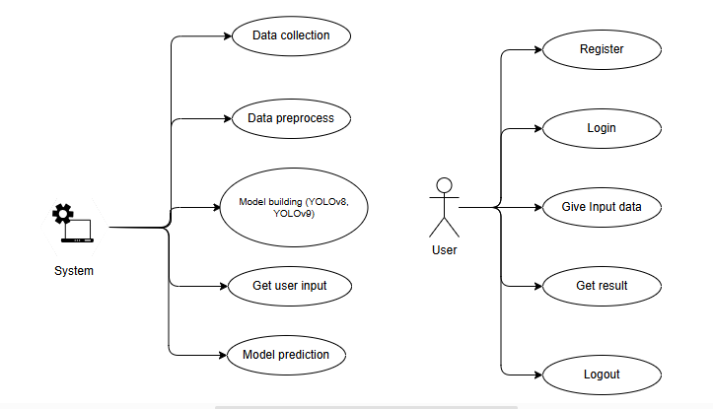
System Design & Implementation
Data Collection
Objective: Collect a comprehensive dataset of images and videos containing instances of fire, smoke, and human presence for training detection models.
Dataset Split: Divide the data into training (70%), validation (15%), and testing (15%) subsets to facilitate effective model training, evaluation, and fine-tuning.

Slide 10
Data Preprocessing
Image Processing: Clean and normalize image data by adjusting brightness, contrast, and color balance. Apply augmentation techniques like rotation, scaling, and flipping to increase dataset variety.
Video Processing: Perform frame extraction, noise reduction, and segmentation on video data. Convert video frames into a consistent format and resolution suitable for model training.
Model Training
Detection Models: Train YOLOv8 and YOLOv9 models using the processed image and video datasets to ensure accurate detection of fire, smoke, and human presence.
Model Evaluation
Performance Metrics: Assess detection models using metrics such as and mAP scores , precision, recall, and F1-score to evaluate model accuracy and effectiveness in identifying fire, smoke, and humans.

Slide 11
User Implementation:
Register: Users create an account to access the fire detection and alert system.Registration includes providing credentials, like user name and password.
Login: Registered users log in to access system features.
Input/Upload Image Feed: Users upload video feeds or connect live camera feeds for real-time monitoring and detection.
Supports video or camera feed integration to monitor areas for fire, smoke, and human presence. Handles receiving and validating input data for processing by detection models.
View Detection Results: Users view detection results for any identified risks.Displays detected instances of fire, smoke, and human presence in real-time.
LogoutL: Users log out to secure their session and personal data.

Slide 12
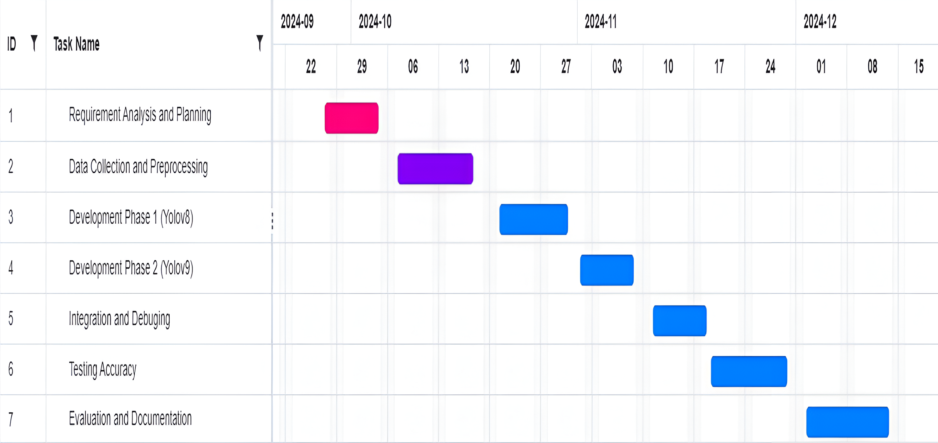
Timeline of Project

Slide 13
Outcomes
Real-Time Detection System: A fully functional application designed to detect humans, fire, and smoke in real-time from uploaded images and live video feeds, providing reliable classification for safety monitoring purposes.
High-Accuracy Detection Models: Successfully trained YOLOv8 and YOLOv9 models, optimized for high accuracy in detecting humans, fire, and smoke under various conditions, with minimal false positives or negatives.
Performance Evaluation and Comparison: A detailed comparison of YOLOv8 and YOLOv9 models in terms of accuracy, speed, and robustness, offering insights into their strengths, weaknesses, and suitability for different real-time detection scenarios.
Real-Time Camera Processing: Implementation of a system capable of processing images from a laptop camera, ensuring effective real-time detection even with potential limitations in resolution and quality, demonstrating its practicality for everyday safety applications.
Visual Feedback System: A responsive system that provides visual cues when humans, fire, or smoke are detected, improving response times in critical situations and enhancing safety and situational awareness.

Slide 14
Conclusion
The training and evaluation metrics confirm that the model has been effectively trained to detect "fire," "smoke," and "human" with improving accuracy. The consistent decline in training and validation losses indicates successful error minimization, while rising precision, recall, and mAP scores (mAP@0.5 and mAP@0.5:0.95) demonstrate the model's growing capability to identify objects across different scales and confidence levels.
Although the model excels in detecting "fire" and "smoke," "human" detection lags slightly, reflected by lower precision and recall scores. Enhancing the dataset or refining model parameters for "human" detection could improve performance in this area.
YOLOv9 shows outstanding performance in detecting "fire" (precision-recall 0.982) and "smoke" (0.855), with minimal misclassifications, making it highly suitable for real-time safety applications like fire and smoke monitoring. However, it struggles with "human" detection (precision-recall 0.536), leading to misclassifications with other classes like background and smoke.
YOLOv8, on the other hand, achieves higher mAP scores and delivers a more balanced performance across all classes, including better "human" detection. Its consistent learning curve and declining losses make it versatile for diverse object detection tasks. YOLOv8 is better suited for general-purpose applications, while YOLOv9 is ideal for high-precision tasks like fire and smoke detection. The choice between the two depends on whether the focus is on specific safety-critical tasks or broader detection needs.

Slide 15
References
[1]. Aathithya, S., Kavya, S., Malavika, J., Raveena, R., & Durga, E. (2020) ‘Detection of Human Existence Using Thermal Imaging for Automated Fire Extinguisher’, Developed a thermal imaging-based system for human detection. Useful for automated fire extinguishing. Limited to thermal detection accuracy.
[2]. Chopde, A., et al. (2022) ‘Forest Fire Detection and Prediction from Image Processing Using RCNN’, Developed an RCNN-based system for forest fire detection. High accuracy in image-based detection. Dependency on large datasets for training.
[3]. Jaradat, F., & Valles, D. (2018) ‘A Human Detection Approach for Burning Building Sites Using Deep Learning Techniques’, Developed a human detection approach using deep learning. Effective in complex environments. Requires extensive training data.
[4]. Jaeseung Baek, Alhindi, T. J., Jeong, Y. S., Jeong, M. K., Seo, S., Kang, J., Shim, W., & Heo, Y. (2021) ‘Real-time fire detection system based on dynamic time warping of multichannel sensor networks’, Developed a real-time fire detection system. High efficiency with multichannel sensor networks. Complexity in sensor network integration.

Slide 16
[5]. Lee, H.-W., Lee, K.-O., Bae, J.-H., Kim, S.-Y., & Park, Y. Y. (2022) ‘Using Hybrid Algorithms of Human Detection Technique for Detecting Indoor Disaster Victims’, Developed a method for detecting disaster victims using hybrid algorithms. Improved detection accuracy in indoor settings. Complexity in algorithm implementation.
[6]. Luo, W. (2021) ‘Research on fire detection based on YOLOv5’, Implemented fire detection using YOLOv5. High detection accuracy. Requires high computational resources.
[7]. Muhammad Salihin Ahmad Azmil, M. S., Ya'acob, N., Tahar, K. N., & Sarnin, S. S. (2015) ‘Wireless fire detection monitoring system for fire and rescue application’, Developed a wireless monitoring system. Wireless, portable, suitable for rescue operations. Limited range of wireless communication. School of Computer Science Engineering & Information Science, Presidency University. 40 Human Life Detection During Fire
[8]. Seetharaman, R., Sreeja, R. R., Dakshin, S., Vidhul, N., Nivetha, N., Gowsigan, S., & Barath, M. (2020) ‘Analysis of a Real Time Fire Detection and Intimation System’, Analyzed real-time fire detection and alert systems. Quick response time, efficient alerting. May face false alarms under certain conditions.
[9]. Sathishkumar, V. E., Cho, J., Subramanian, M., et al. (2023) ‘Forest fire and smoke detection using deep learning-based learning without forgetting’, Developed a system for detecting forest fires using deep learning. Adaptive learning capabilities. High computational demand for training.

Slide 17
[10]. Zaher, A., Al Faqsh, A., Abdulredha, H., Al-Qudaihi, H., & Toaube, M. (2021) ‘A Fire Prevention/Monitoring Smart System’, Developed a smart system for fire prevention and monitoring. Real-time monitoring and prevention. Dependency on sensors, high cost.

Slide 18
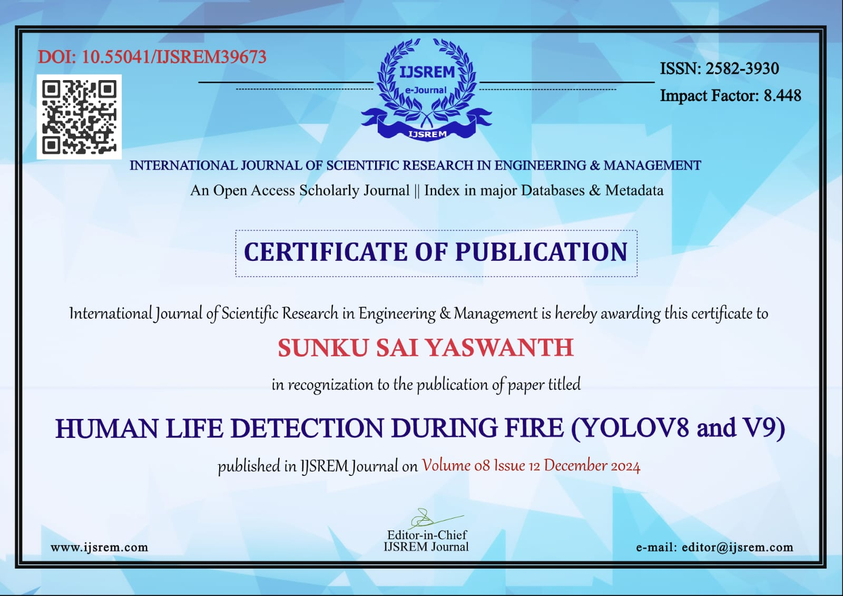
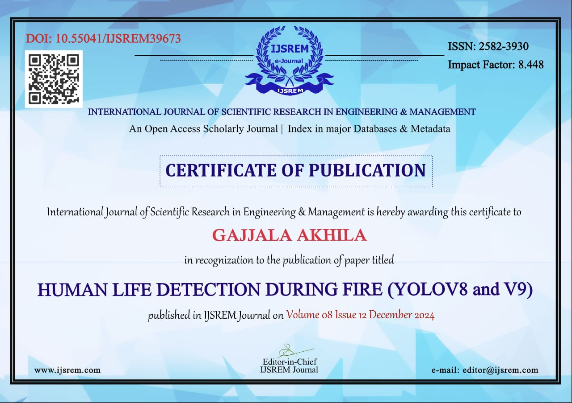
Proof Of Publication:

Slide 19
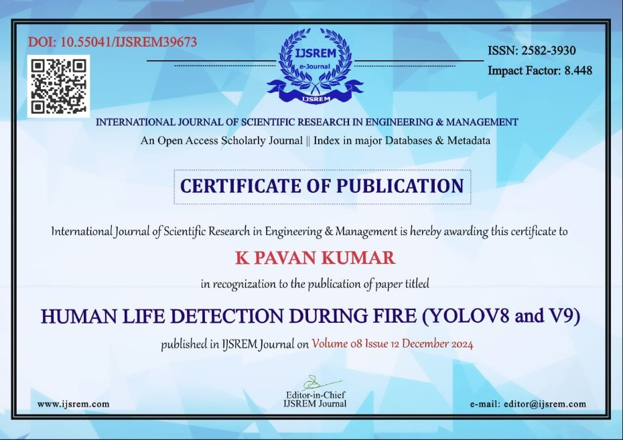

Slide 20

SDG 9: Industry, Innovation, and Infrastructure
SDG 11: Sustainable Cities and Communities

Slide 21

Thank You

